Slide 1


Welcome to a CZU Fire Area Community Meeting
Rebuilding Topic:
Septic and Water Systems
May 1, 2021

Slide 2
RECOVERY PERMIT CENTER
701 Ocean Street
Community Room
Santa Cruz, CA 95060
Please contact us!
To make an appointment (required)
Visit: rpcappt@timetap.com
Call: (831) 454-5323
Email: rpc@santacruzcounty.us
Hours of Operation
Monday - Friday
8AM – 12PM, 1PM – 5PM

Slide 3
RECOVERY PERMIT CENTER
PRIMARY CONTACTS
Mike Renner, CBO
(925) 785-3581
mrenner@4leafinc.com
Marcus Johnson
(925) 785-3315
mjohnson@4leafinc.com

Slide 4
MEETING PROTOCOL
This meeting will be recorded and the chat will be preserved.
We will mute everyone to prevent background noise.
Hold questions until after the presentation, as many things may be answered as we go through the presentation.
For questions, if you are on a computer, please type your question in the chat function OR use the raise hand function so someone can call on you. We will ask you to unmute when you are called on.
Be respectful, don’t interrupt others, ask only one question at a time so others can ask as well.
After the meeting questions can be asked at the Recovery Permit Center or by emailing http://www.co.santa-cruz.ca.us/FireRecovery/AsktheRecoveryTeam.aspx

Slide 5
AGENDA
Purpose and Introductions
Septic System Basics
  Regulations that apply
  Types of systems
  ADUs
Environmental Health Pre-Clearance
Septic Site Evaluations
Permits
Questions and Responses
a

Slide 6
Purpose
Present septic system basics: the” why” and ”what” of the regulations, and how septic systems work
Describe the path to obtaining an Environmental Health Pre-Clearance (on the way to a building permit)
Respond to your questions and concerns
Introductions
Paia Levine
Dr. Marilyn Underwood
Marcus Johnson

Slide 7
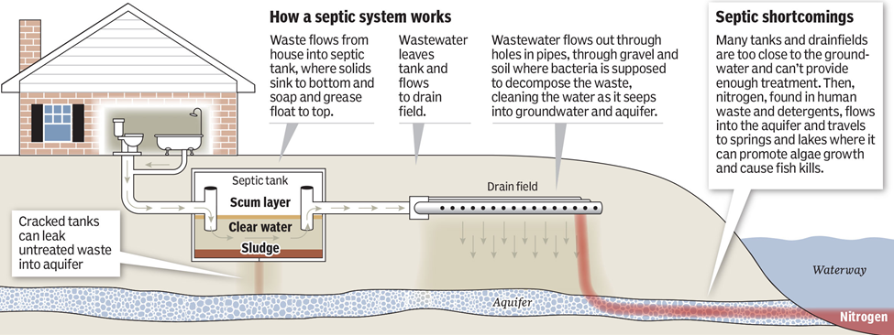
Most homes in the CZU burn area have a septic system to treat wastewater. Most homes also have wells for drinking water.
If a septic system is not working properly or is too close to the drinking water source or a creek or waterway, the wastewater may contaminate the drinking water supply or the creek.
About half the burn area creeks drain to the San Lorenzo River, a major source of drinking water for the community.
Septic Systems and the Environment

Slide 8
Design Standards for Rebuilding are in the Santa
Cruz County Code and State Regulations
Summary:
7.38.080 (A-D) Existing system—Building alterations.
(B) A one-time addition to any legal residential structure of up to 500 square feet with no increase in bedrooms may be approved to the existing sewage disposal system. Provided that:
  New square footage does not encroach on the existing system or expansion area.
  The existing system is in functioning without failure.
  There is adequate information on the location, construction and function of the existing system.
  Legal structures that meet the requirements of this section do not need to meet the minimum lot size provision.

Slide 9
7.38.080 Existing system—Building alterations. (Cont.)
(C) Reconstruction of Occupied Structures Destroyed by Fire or Calamity.
  Legal structure for residential or commercial use, constructed with a building permit or prior to the requirement for building permits.
  Sewage disposal system to serve the rebuild shall be upgraded to meet current standards, or demonstration the existing system meets standards and is in functional condition.
  Combine any contiguous undeveloped lots to achieve a minimum parcel size of 15,000 square feet.
(D) Any proposed new use or proposed expansion of an existing use can only be approved if all existing and proposed uses on the parcel can be served by a sewage disposal system that meets the requirements for a standard system or alternative system.

Slide 10
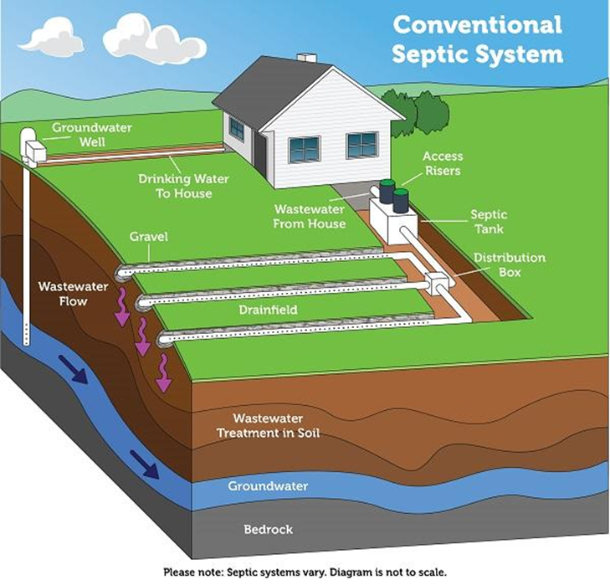

Slide 11
Standard/Conventional Septic System
A wastewater treatment system consisting of a septic tank and a subsurface drain field.
The gravel/stone drain field is a design that has existed for decades. Effluent is piped from the septic tank to a shallow underground trench of stone or gravel. A geofabric or similar material is placed on top of the trench so sand, dirt, and other contaminants do not enter the clean stone.
Effluent filters through the stone and is then further treated by microbes in the soil below the trench.
Conventional drain fields are relatively large in overall footprint and are not suitable in every situation.

Slide 12
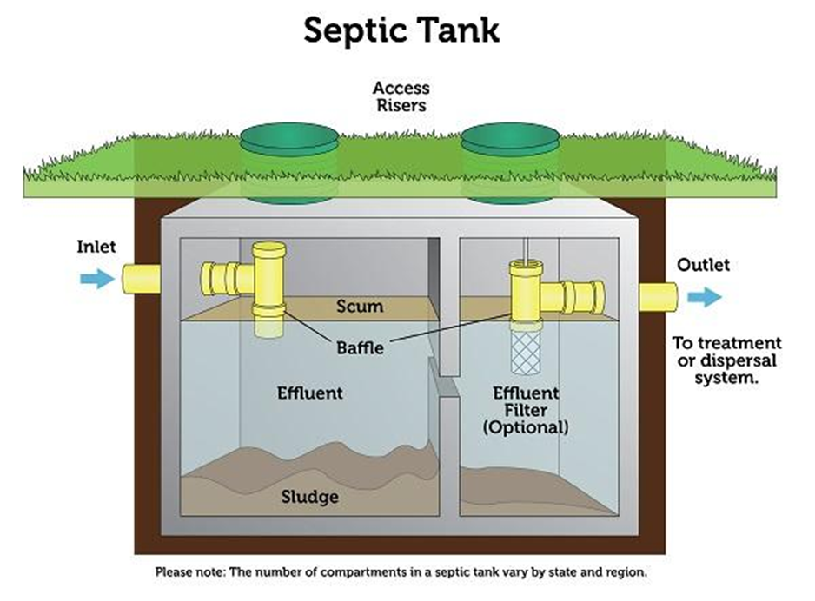
Septic Tanks
A buried, watertight tank receives and partially treats raw wastewater.
Heavy solids settle to the bottom while grease and lighter solids float to the top.
The solids stay in the tank while the wastewater is discharged to the drain field for further treatment and dispersal.

Slide 13
Septic Tank Standards are Set by Code
7.38.140 Septic tank requirements. (summary)
(A) The septic tank size for one to four bedrooms is 1,500 gallons. Each added bedroom = an additional 250 gallons.
(B) Septic tanks shall have at least two separate compartments. The minimum inlet compartment capacity is 2/3 of the total volume. Each compartment shall have a min. 20” manhole with a close-fitting cover.
(C) Manhole covers must be within 12 “ of the surface. \. A cleanout to finished grade shall be provided between the house and the septic tank.

Slide 14
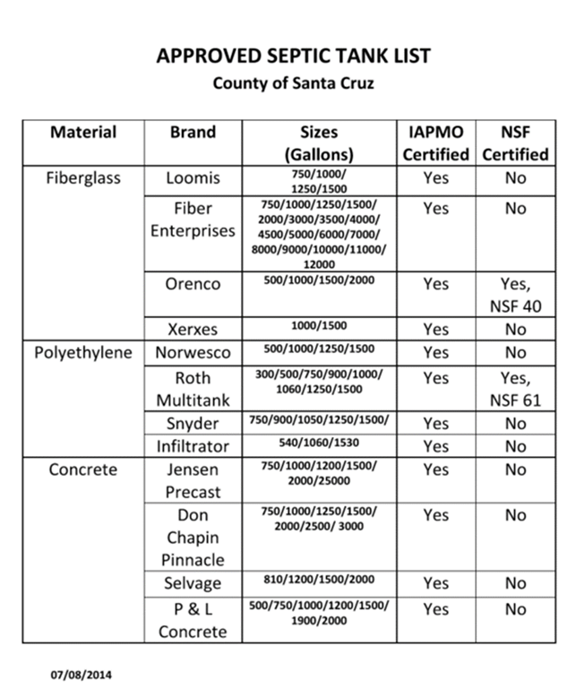
Septic Tanks
7.38.140 Septic tank requirements. (Cont.)

Slide 15
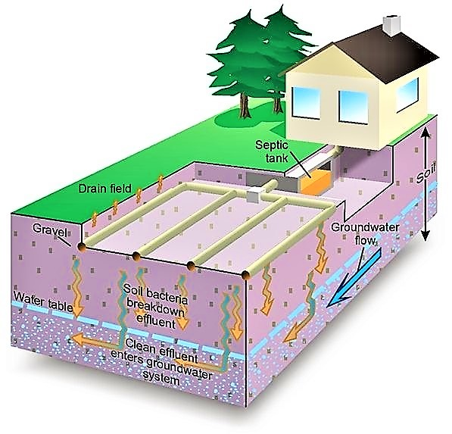
Leach fields
A leach field disposes of the clarified wastewater from the septic tank into the ground. Factors in designing a leach field:
Depth to groundwater (especially during the rainy season);
Percolation Rate: the ability of the soil to soak up the water from the leach field;
Space: the amount of land available on the parcel to install the leach field; and
Size: The size required for a reserve area is also taken into account.

Slide 16
Leach fields (Cont’d)
  Determination of Soil Percolation Rate:
    Soil Survey: soil type, soil texture
    Levels of the water table to leach depth
    Setback to waterways
    Formal percolation test may need to be completed
  Effective Leaching Area:
    The size of the leach field is determined by the total of the areas of the trench bottom and sidewalls beneath the leach pipe.
  Expansion Area:
    An expansion area able to accommodate a duplicate of the approved leach field. No construction of buildings, swimming pools or other permanent structures are permitted over the expansion area.

Slide 17
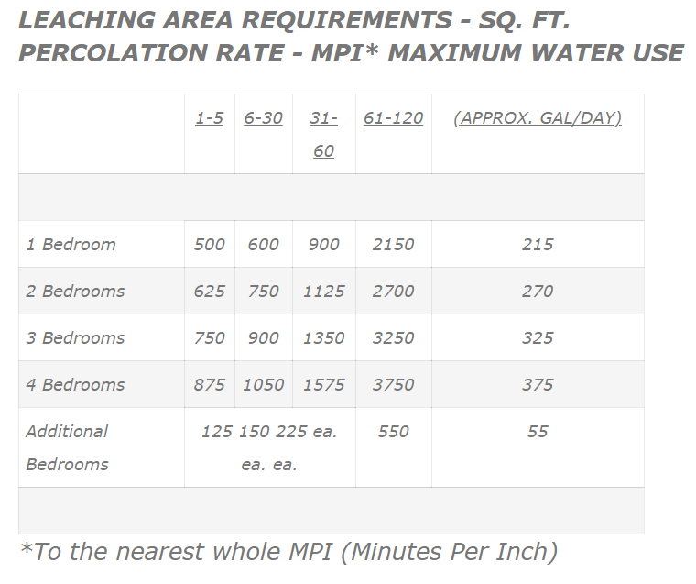
Leach fields (Cont’d)

Slide 18
Non-Standard Systems
A Nonstandard System or Enhanced Treatment System: either uses alternative technology, or does not meet critical requirements for a standard conventional septic system and is allowed only with certain conditions in place.
Examples of Non-Standard systems:
An Alternative System utilizes alternative technology to meet requirements and may enable bedroom and other additions if the system can accommodate the wastewater peak flow.
A Limited Expansion System meets requirements for a standard system except for:
  groundwater separation (at distances over 250 feet from a waterbody)
  or expansion area.
  .

Slide 19
Non-Standard Systems
A Limited Expansion system:
  Requires water conservation measures;
  Enables a one-time addition of up to 500 sq.ft. of conditioned space with no bedroom additions, and no increase in the volume of wastewater discharge;
  Additions will not be approved which encroach on the septic system or any area of the property needed to install a replacement system which meets the requirements for a standard system to the greatest extent possible;
  As long as the system performs well, no annual inspection fee is charged.

Slide 20
Non-Standard Systems
A Low-Flow System meets the requirements for a standard system except for leach field area or size of pump chamber for pump up systems.
A Low-Flow system requires water conservation measures
Enables only a one-time addition of up to 500 sq.ft. of conditioned space with no bedroom additions, and no increase in volume of wastewater discharge.
Additions will not be approved which encroach on the septic system or any area of the property needed to install a replacement system which meets the requirements for a standard system to the greatest extent possible.
An annual inspection fee is charged on the tax bill.

Slide 21
Non-Standard Systems
Enhanced Treatment (ET) System
ET assists properties with constraints: high groundwater, sandy soil, slow perc soils, fast perc soils, steep slopes, small lots and setback restrictions to waterways or cut banks.
ET adds an extra component to treat effluent more efficiently. Often this allows a smaller leach field.
Installation is usually more expensive, requiring a consultant, additional testing, and inspections.
Because ET has special operating conditions, a notice of a non-standard system is recorded on the deed, and payment of an annual inspection fee to confirm continued satisfactory performance (fee waived for Limited Expansion Systems).
The goal is to reduce Biochemical oxygen demand (BOD), Suspended Solids and Nitrogen levels.

Slide 22
Non-Standard Systems
Enhanced Treatment System
These are enhanced treatment septic systems that are approved in Santa Cruz County:
Acqualogic - http://acqualogic.com/about/the-acqualogic-team/
AquaKlear - http://www.betterthan septic.com
Orenco Advantex – http://.orenco.com/
Microseptec Enviroseptic – http://www.microseptec.com/distributors-home.htm
HOOT – http://hootsystems.com/components/treatment.html
Mound – http://ahioline.osu.edu/aex-fact/0744.html
Multi Flo - http://sewageeq.com/Multi-flo.html
Sand Filtration http://www.extension.umn.edu/distribution/naturalresources/DD7672.html

Slide 23
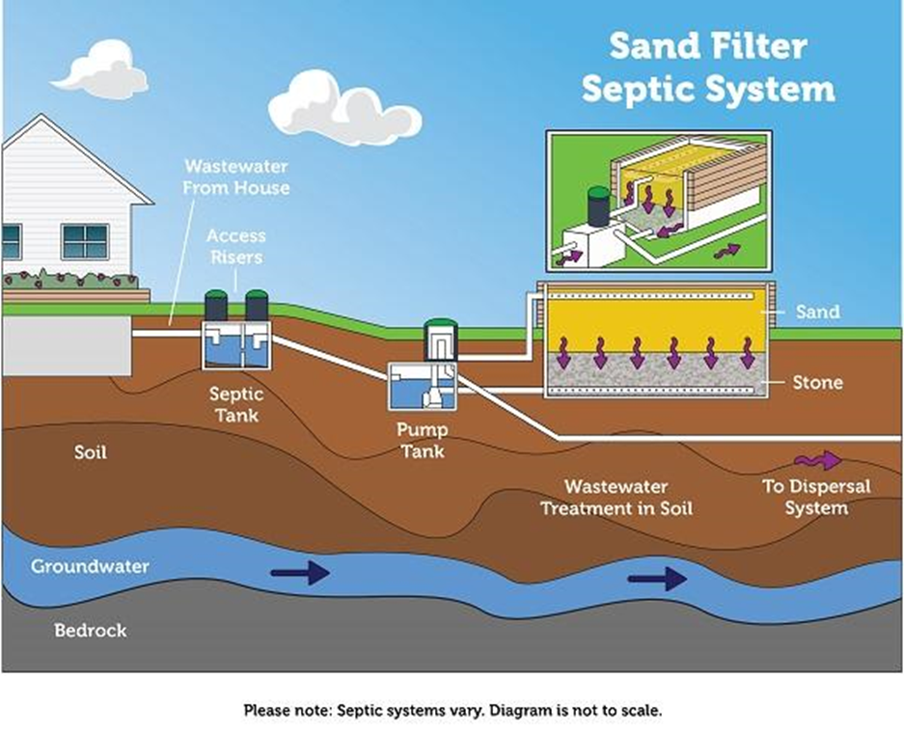
Sand filter systems can be above or below ground. Effluent flows from the tank to a pump chamber to the sand filter. Effluent is pumped under low pressure through the pipes at the top of the filter. The effluent leaves the pipes and is treated as it filters through the sand. The treated wastewater is then discharged to the drain field.
Sand filters provide a high level of treatment for nutrients and are good for sites with high water tables or that are close to water bodies, but they are more expensive than a conventional septic system.
Recirculating Sand Filter System

Slide 24
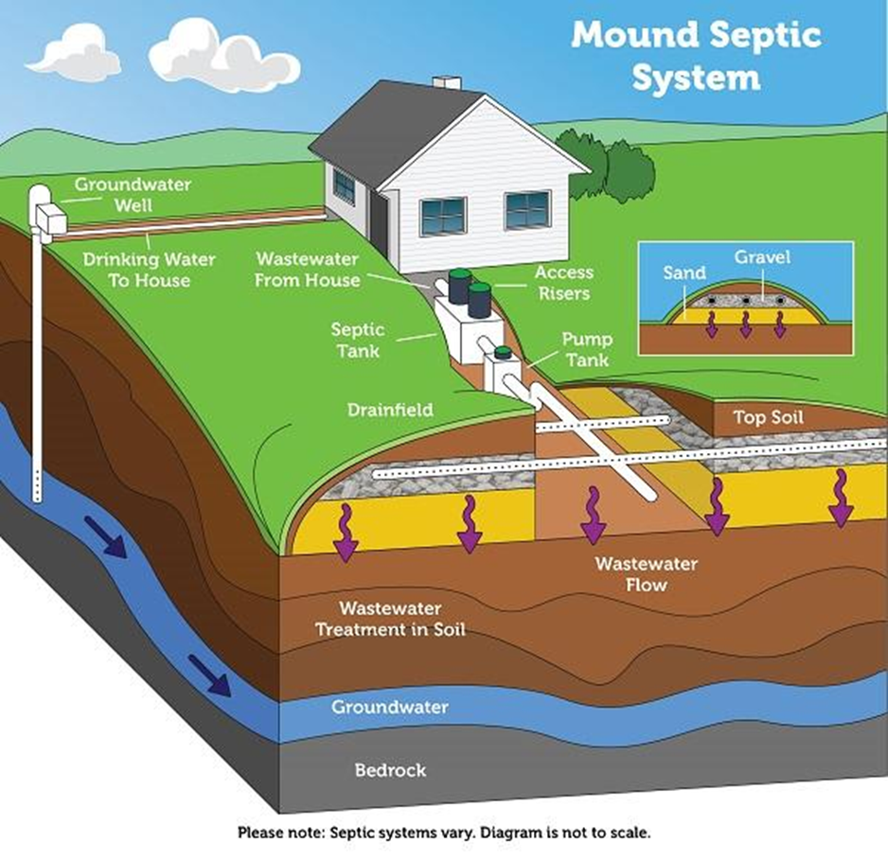
Mound systems are an option for shallow soil depth, high groundwater, or shallow bedrock. The sand mound contains a drain field trench. Effluent flows from the tank to a pump chamber, where it is pumped to the mound in prescribed doses.
Treatment occurs as effluent discharges to the trench and filters through the sand, and then disperses into the native soil.
While mound systems can be a good in certain soil conditions, they require a substantial amount of space and periodic maintenance.
Mound Systems

Slide 25
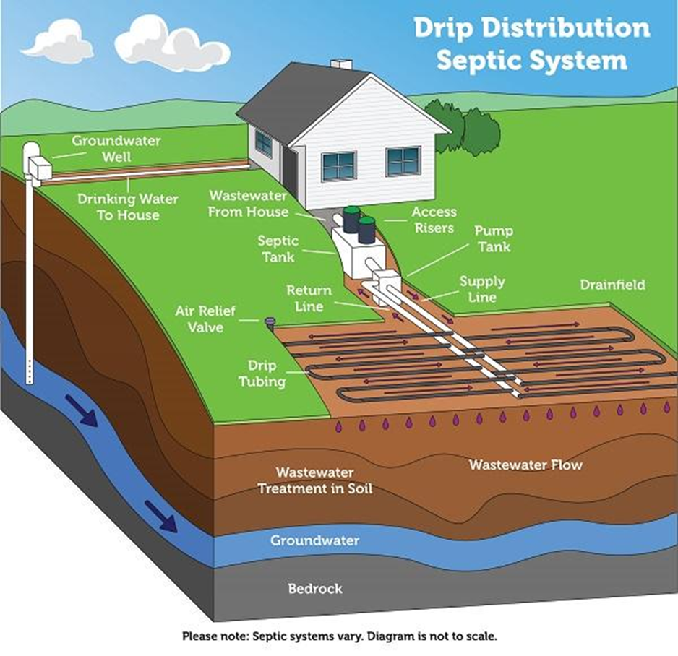
Drip Distribution System
The main advantage of the drip distribution system is that no large mound of soil is needed as the drip laterals are inserted into the top 6 to 12 inches of soil.
The disadvantage is that it requires a large dose tank after the septic tank to accommodate the timed dose delivery of wastewater to the drip absorption area.
Additional components, such as electrical power, are necessary for this system, requiring an added expense and increased maintenance.

Slide 26
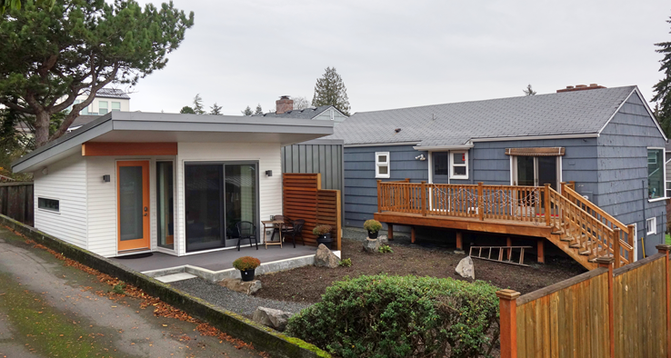
ADU Septic System
Adding a new ADU means that a sewage disposal system that can accommodate the wastewater load from the ADU must be installed.
A 1500-gallon tank for the ADU is required
The ADU leaching is calculated with the bedroom counts plus additional from the kitchen, laundry. Etc.
  Properties larger than 2 acres can install a second sewage disposal system to accommodate the ADU
  Properties smaller than 2 acres will need to account for leaching that will cover both the main house and ADU. This will also be required 100% expansion.

Slide 27
ADU Septic System
Phasing your project can provide flexibility to construct the ADU first or after the main home is rebuilt.
Building the ADU first
  Connecting to the permitted existing system can be accommodated.
    Preplanning and setting up phased construction to have the most success.
Building the Main home then an ADU
  Will outline the normal process to have a sewage disposal system at issuance of building permits.
Building the Main home and ADU at the same time
  Properties larger than 2 acres can install a second sewage disposal system to accommodate the ADU
  Properties smaller than 2 acres will need to account for leaching that will cover both the main house and ADU. 100% expansion will also be required.

Slide 28
Environmental Health Pre-Clearance
The Environmental Health Pre-Clearance addresses:
whether the sewage disposal system is properly sized for rebuilding “in kind”;
determines any system requirements when rebuilding larger or adding uses (such as a new ADU) to the property;
checks the permit history of the system and the record of how the system is functioning;
confirms setbacks are met for groundwater, distances to creeks, wells, etc.

Slide 29

Environmental Health
Pre-Clearance
Site plan guidance is found on the website:
https://www.santacruzcounty/FireRecovery/

Slide 30
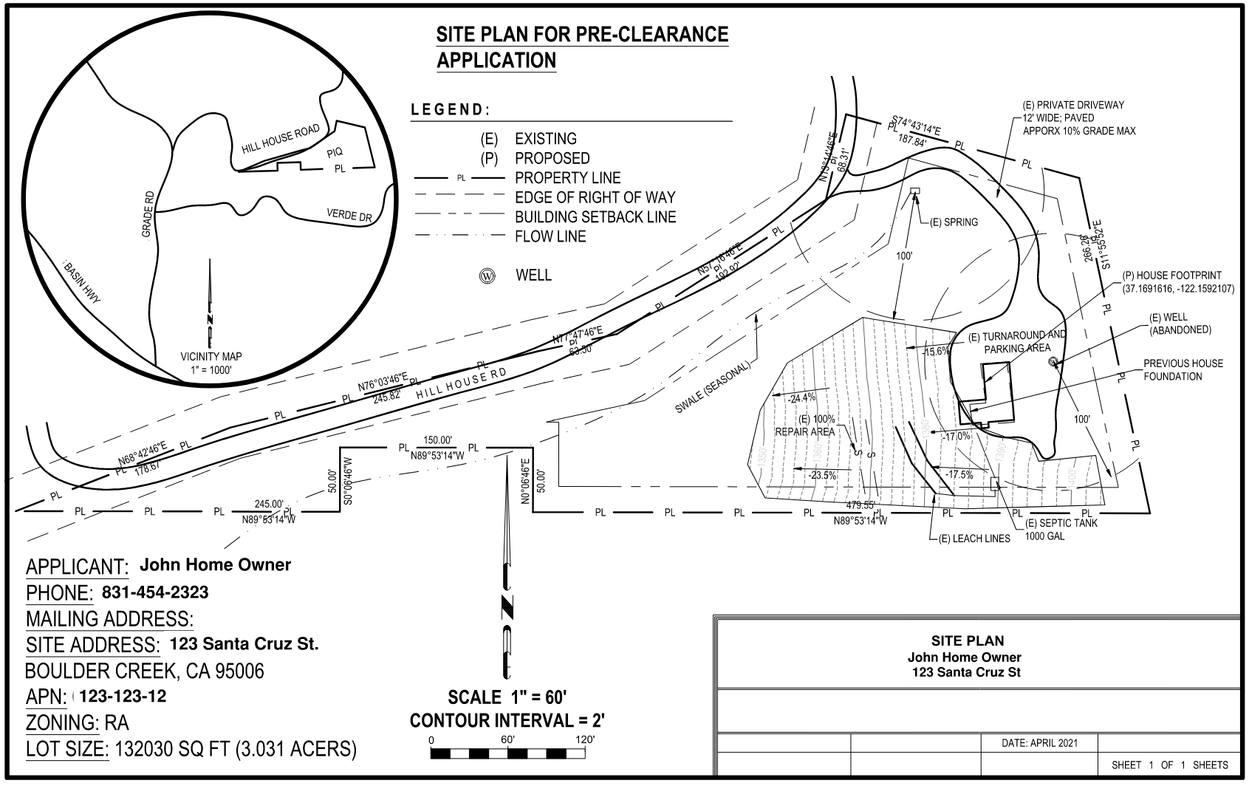
Environmental Health Pre-Clearance

Slide 31
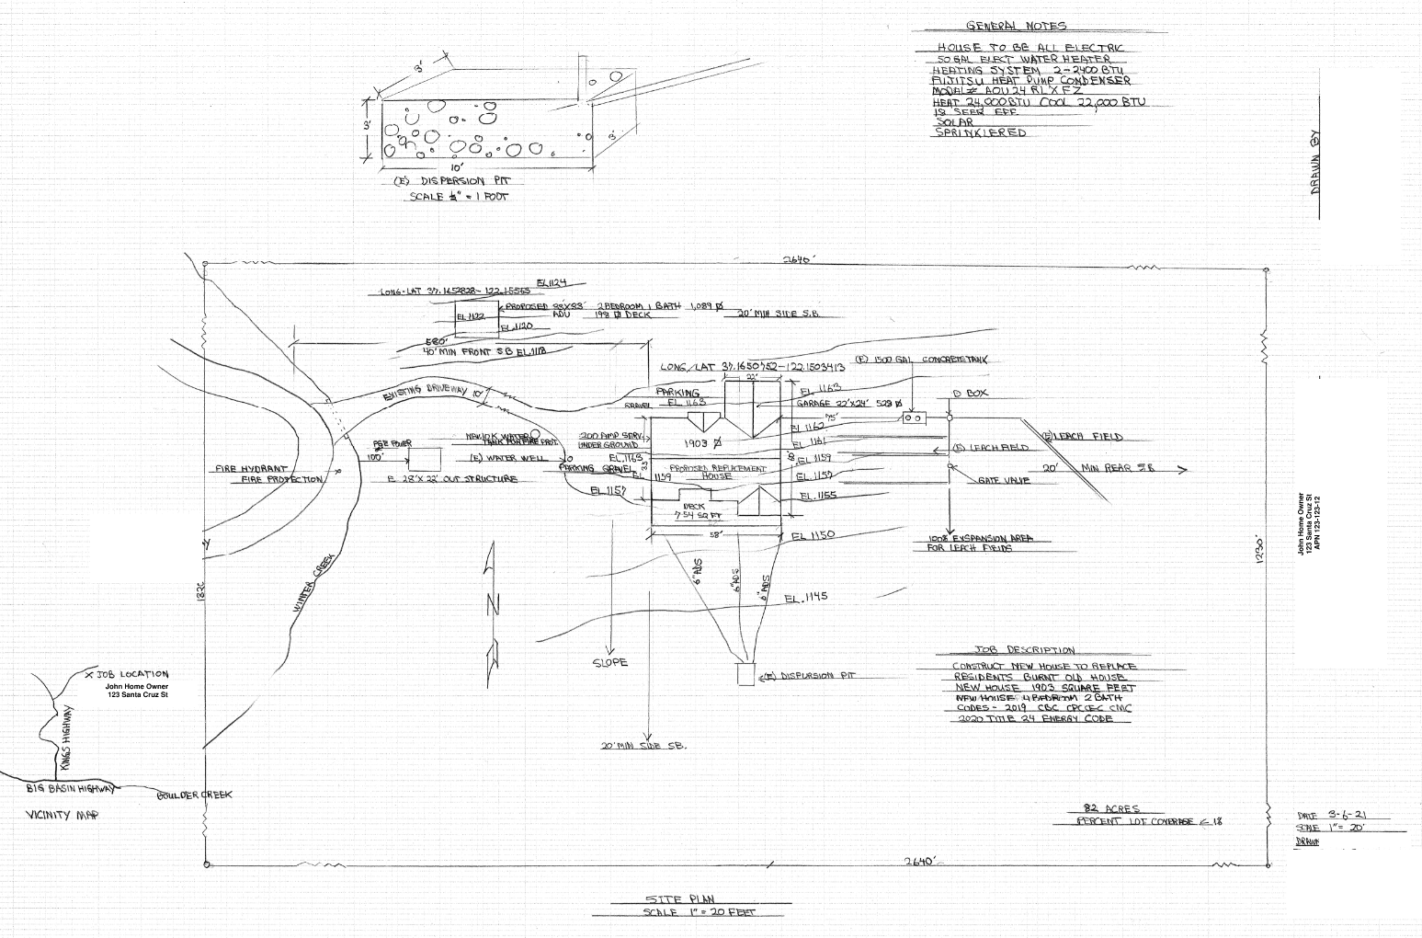
Environmental Health Pre-Clearance

Slide 32
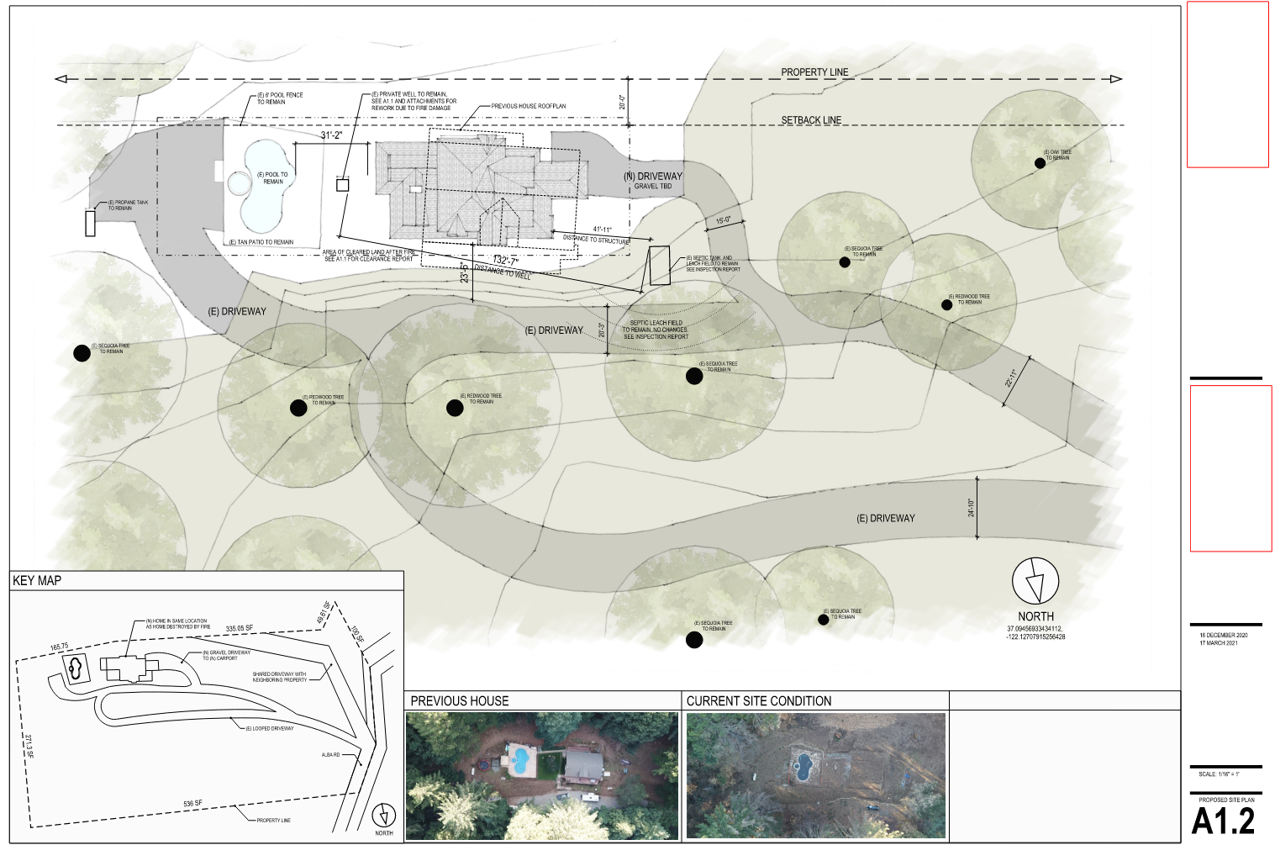
Pre-Clearance Environmental Health Review

Slide 33
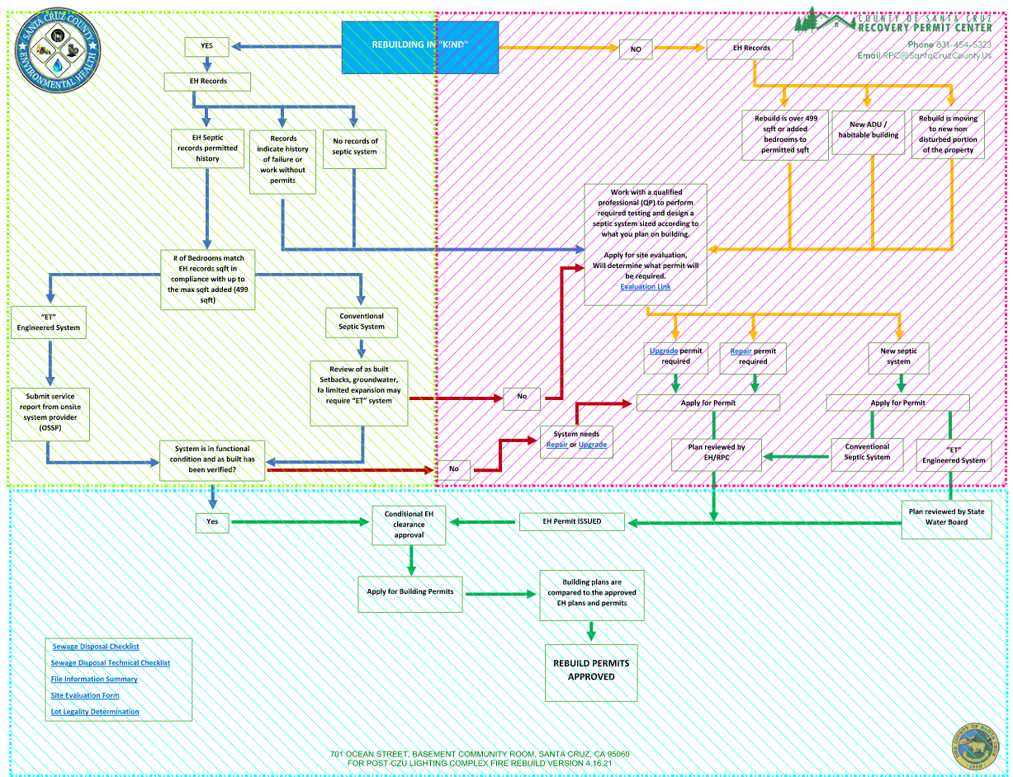

Slide 34
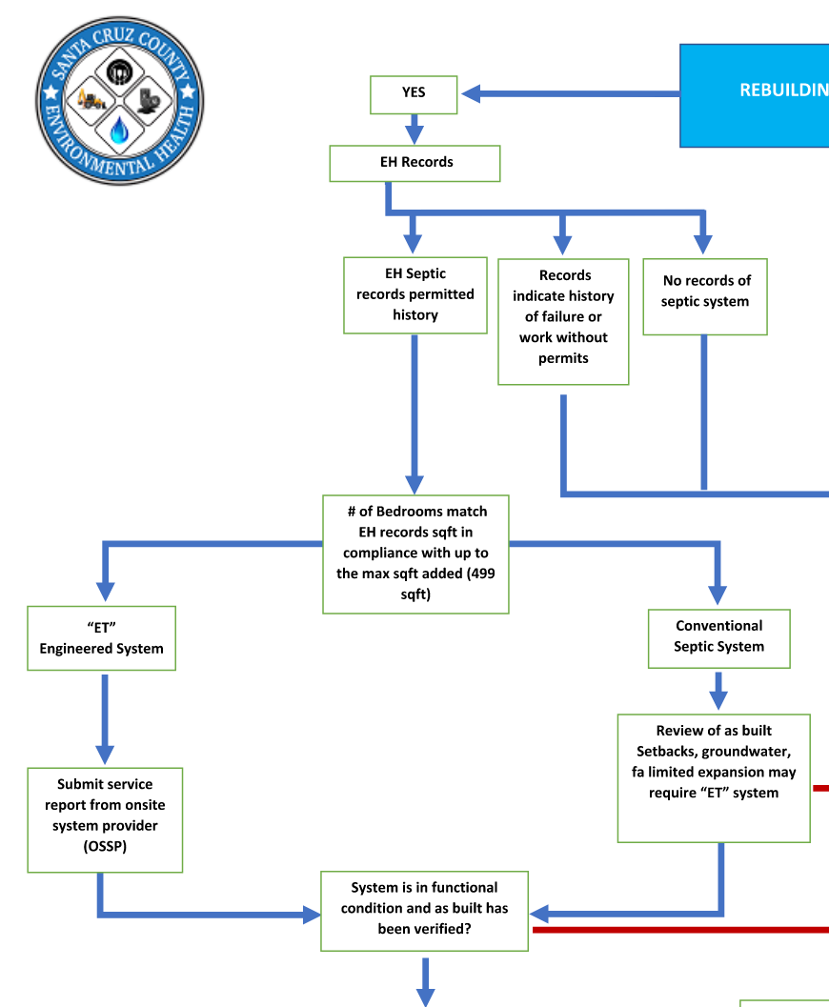
Pre-Clearance Results

Slide 35
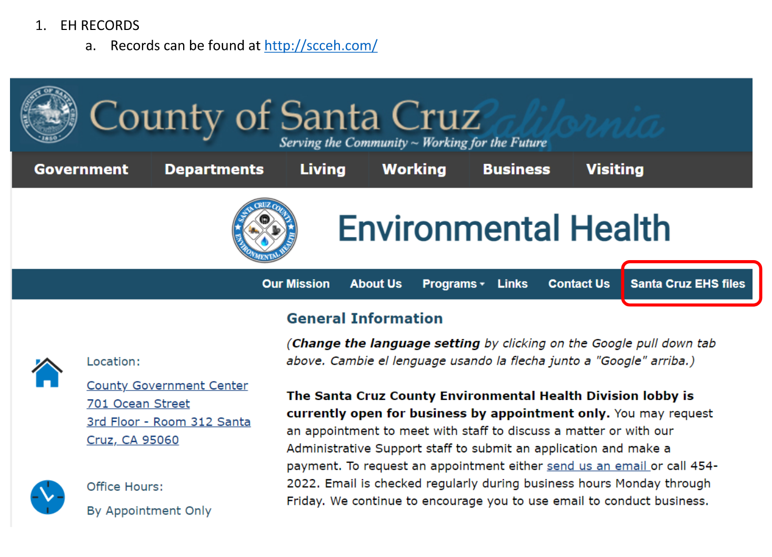
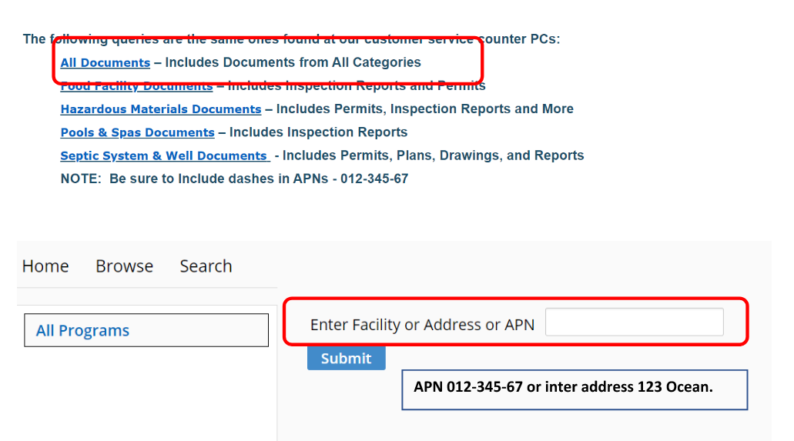
Pre-Clearance Results

Slide 36
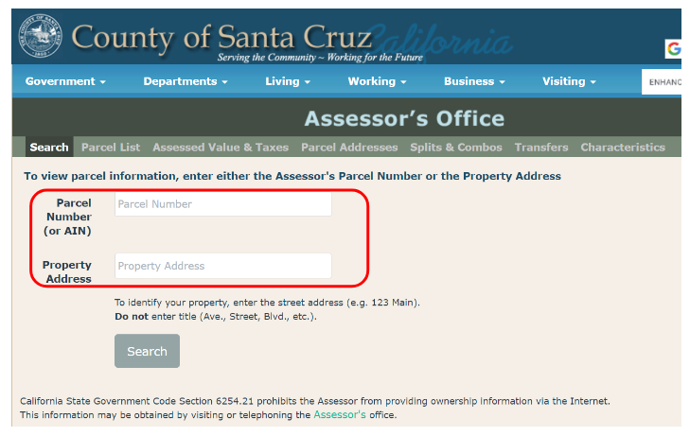
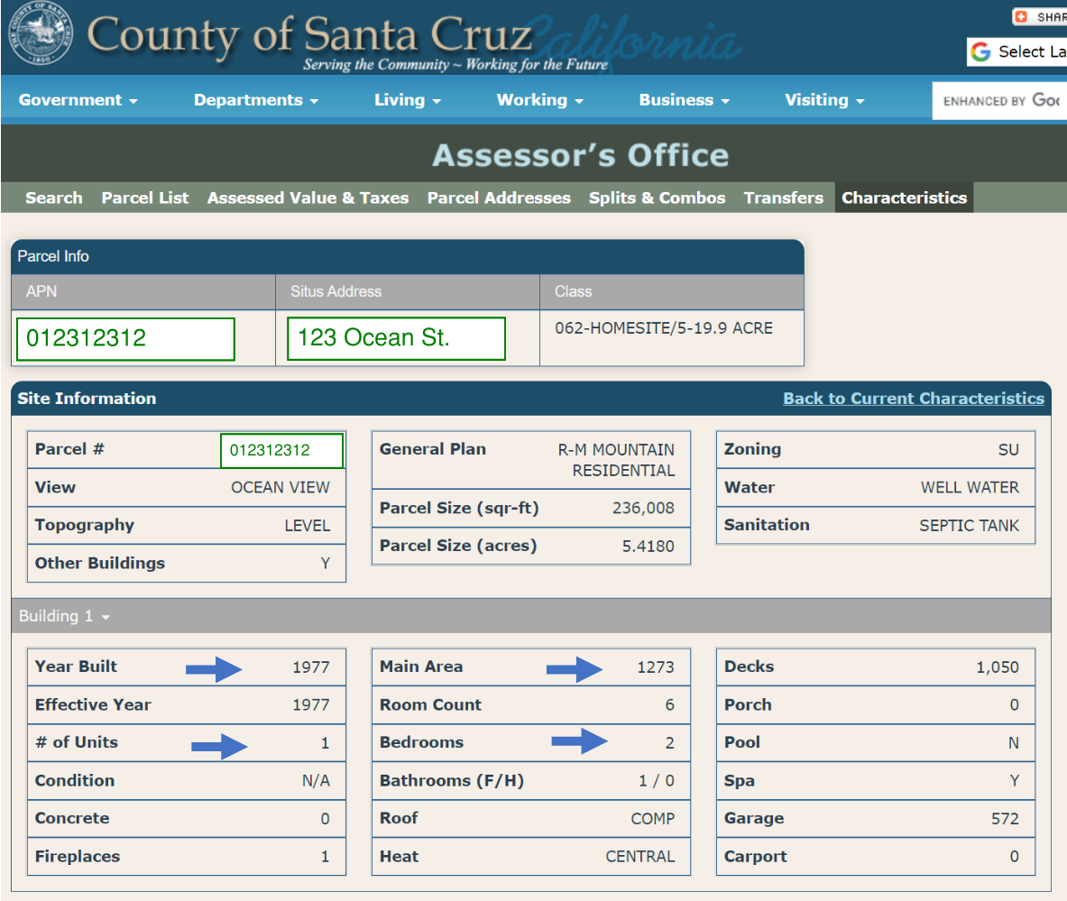
Pre-Clearance Results

Slide 37
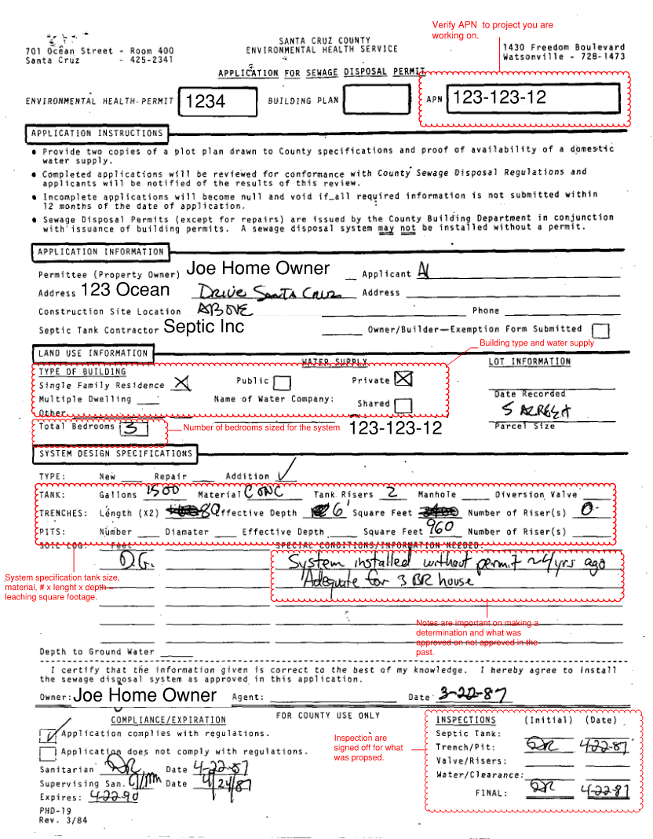
Pre-Clearance Results

Slide 38
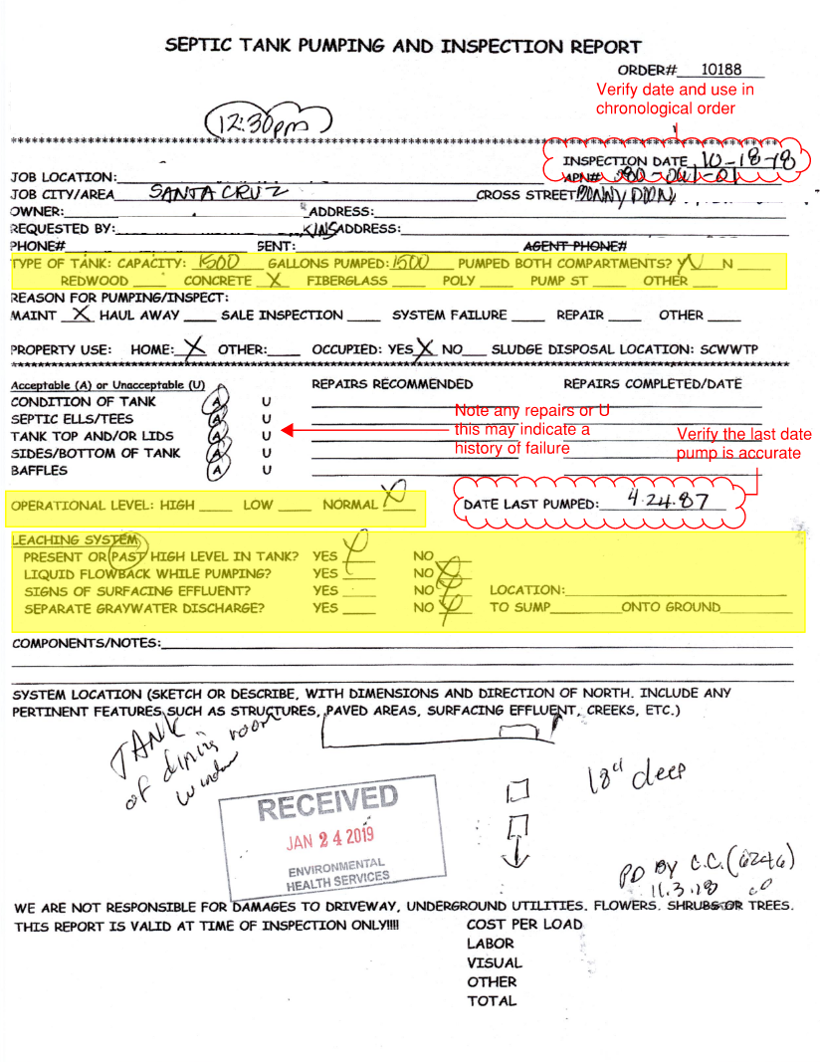
Pre-Clearance Results

Slide 39
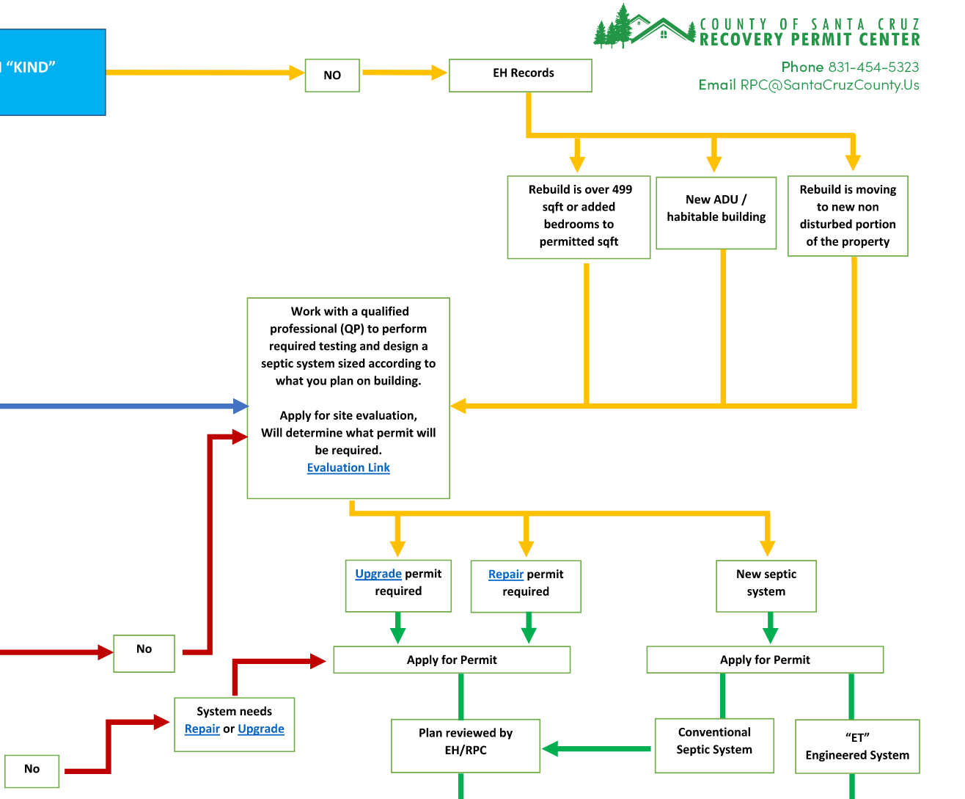
Pre-Clearance Results

Slide 40
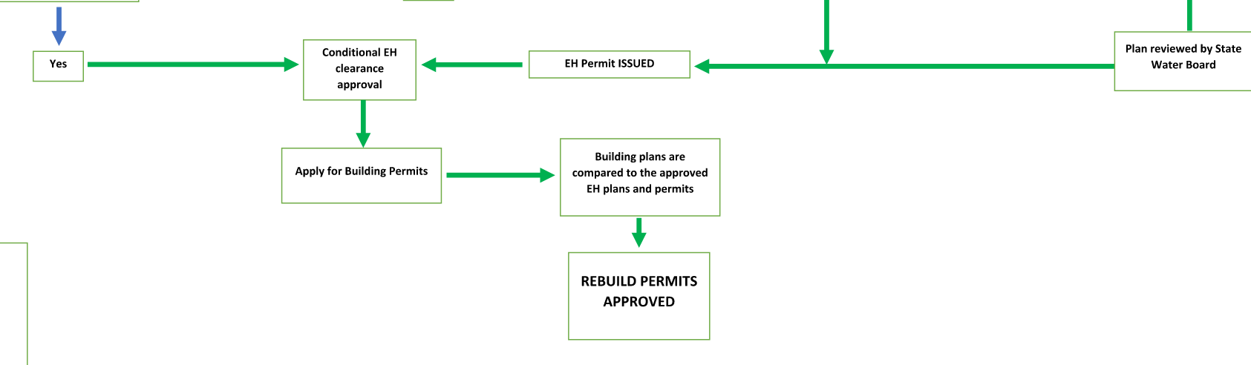
Pre-Clearance Results

Slide 41
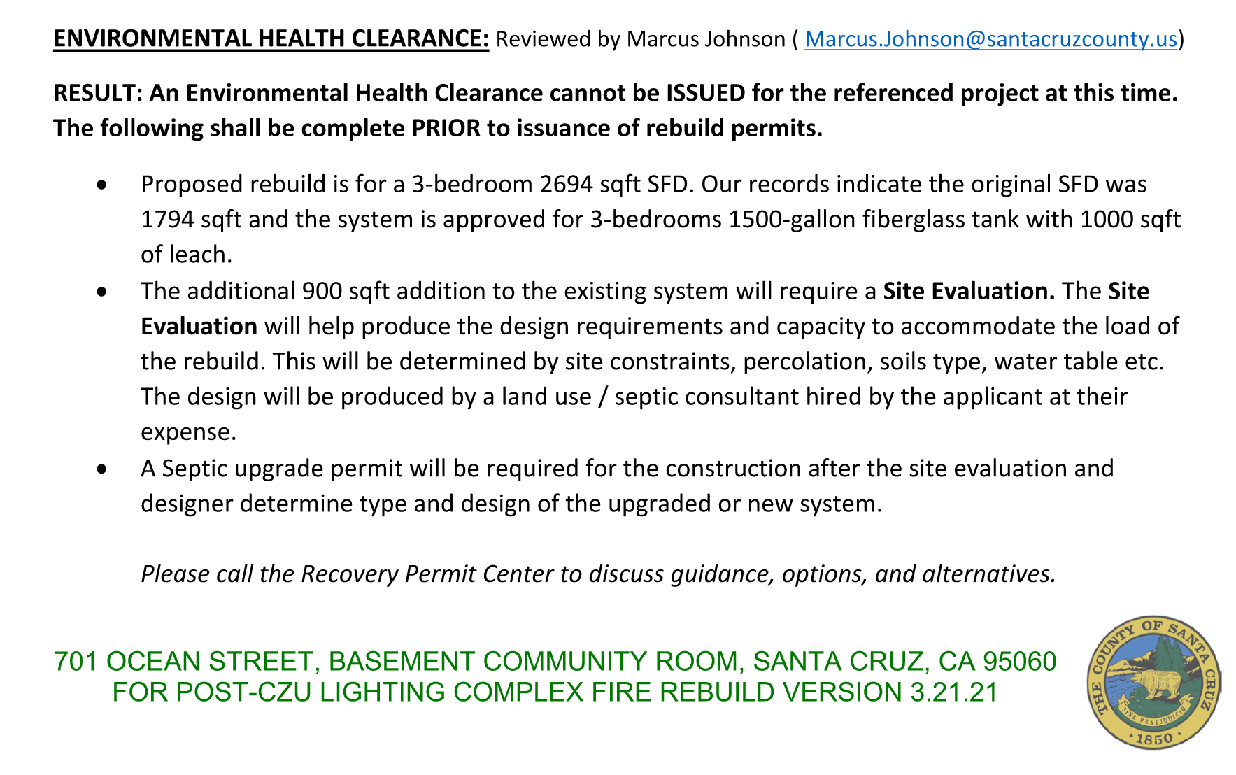
Pre-Clearance Result

Slide 42
Site Evaluation
The two primary objectives in evaluating a site are:
To ensure that the soil is permeable and will accept wastewater effluent for a long time without causing sewage to backup or surface, and,
To ensure that the wastewater is adequately treated by the soil to limit bacterial or nutrient contamination of groundwater, surface water or drinking water.
Soils that meet both objectives are permeable (coarse) enough to allow effluent to flow down through the soil horizons yet fine enough to filter or treat the effluent before reaching groundwater. To adequately treat the wastewater, the soil should be unsaturated condition. If the groundwater is too near (closer than 4') the bottom of the disposal trench, contaminants can reach the groundwater without adequate treatment. Saturated soils will also cause anaerobic conditions and chemical changes that can inhibit infiltration of effluent causing a system to surface or back up.
Site Evaluation Components
A site evaluation consists of several parts:
Assessing the physical characteristics of a parcel
Evaluating the soils
Submitting a complete report

Slide 43
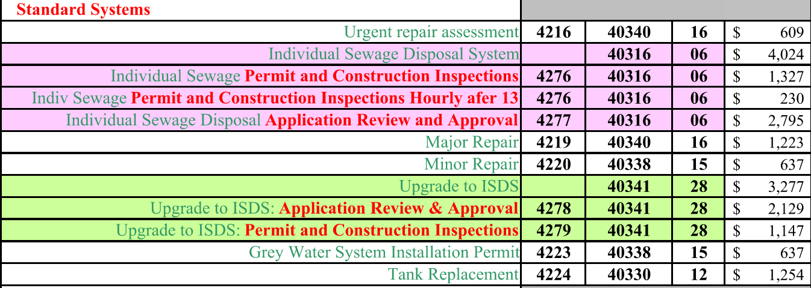
Permits
Repair Permits
  Major : Are repairs made that consists of repairs to the leach fields
  Minor : Repairs to the system that are small components, distribution boxes, risers, tight lines etc.
  Tank Only (Replacement of damage tanks body)

Slide 44
Permits
New Systems
  Standard System are submitted and reviewed through the RPC. Working with the designer and applicant to submit a complete package that meets the design parameters from the site evaluation.
  Enhanced Treatment System are submitted to the state water board for review. The reviews are done by the state, but the RPC will help facilitate a complete package that will help expedite review.
LAMP & State Water Board

Slide 45

QUESTIONS/COMMENTS?

